Slide 1










Team 1 co.
Mamma Mia
Pizzeria
Analysis Plan

Slide 2



Navigation
Content | Page
Problem Statement | 3
Data Collection | 4
Handeling Data using PL/SQL | 8
Dimensional Modeling & Informatica | 18
BI Queries To Extract Insights | 23
Visualizing Analysis Using Power BI | 36
Application Demo | 41

Slide 3







Problem Statement
01
Lack Of Data Existence For Restaurants
02
Limited Features of Found Data
03
Integrate Application & Database
Team 1 co.

Slide 4



Orders | Order Items
Supplier | Reservation
Inventory | Item Ingredients
Employee Info & Performance | Menu
Seating | In & Out Times
Data Collection
Data Sources
Kaggle / GitHub

Slide 5
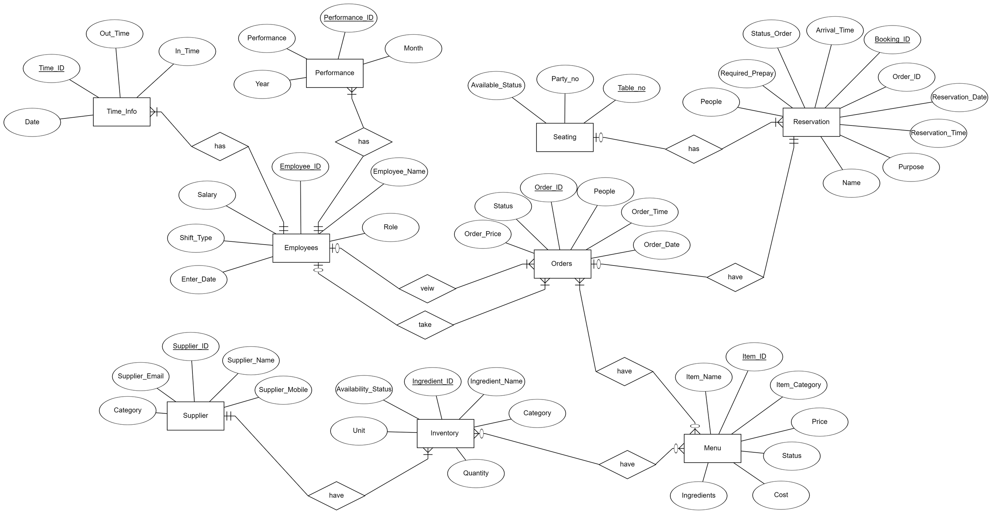
Data Collection

Slide 6
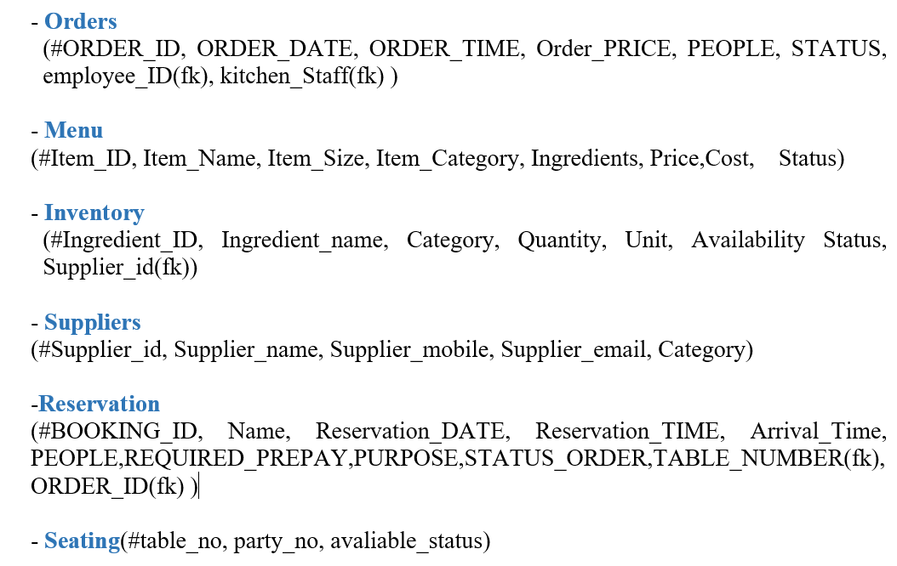
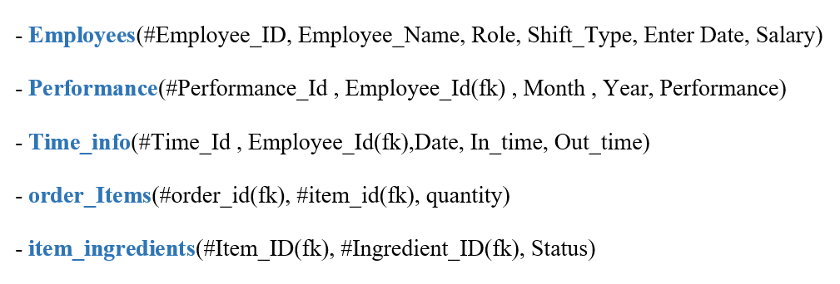
Data Collection

Slide 7
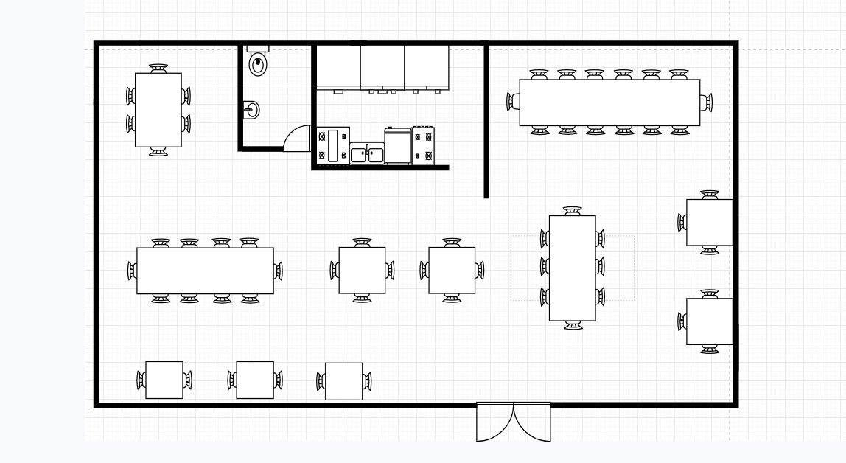
Data Collection
Seatings Arrangement Visualization:

Slide 8




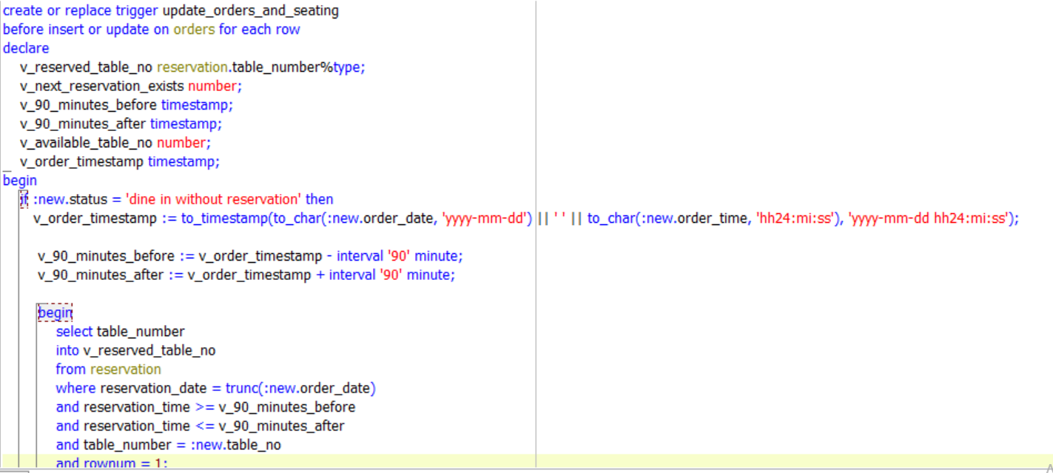
Team 1 co.
Handeling Data using PL/SQL
PL/SQL Queries Integrated With Application
Trigger to assign tables to ‘Dine in without Reservation’

Slide 9
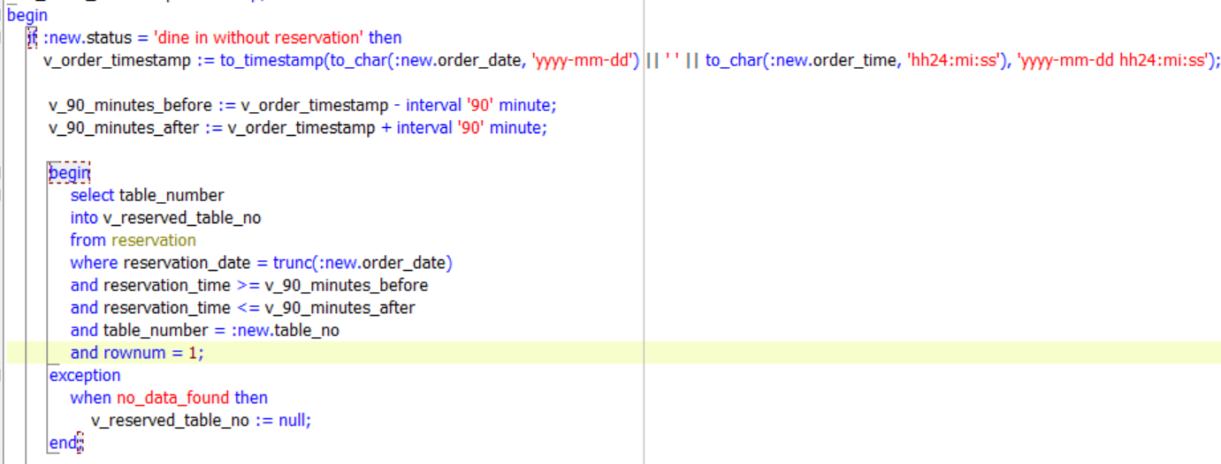
Team 1 co.
Handeling Data using PL/SQL
PL/SQL Queries Integrated With Application
Trigger to assign tables to ‘Dine in without Reservation’

Slide 10
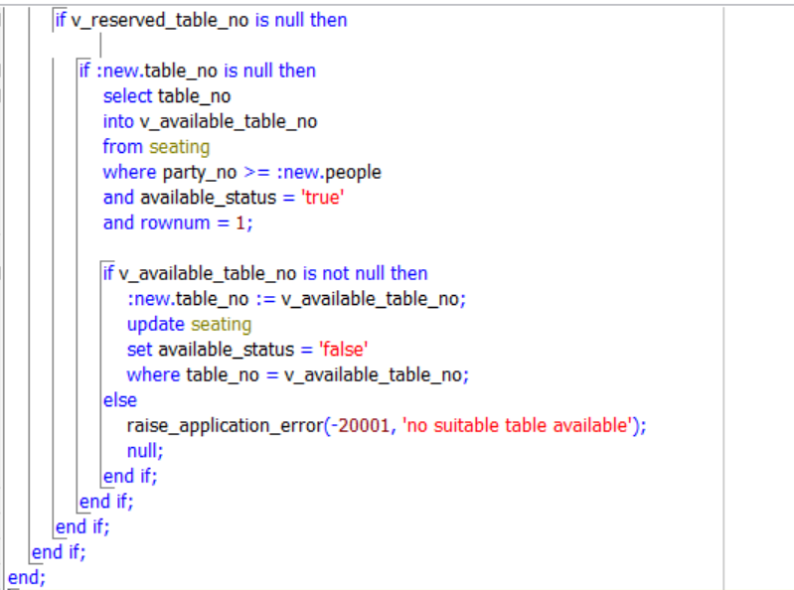
Team 1 co.
Handeling Data using PL/SQL
PL/SQL Queries Integrated With Application
Trigger to assign tables to ‘Dine in without Reservation’

Slide 11
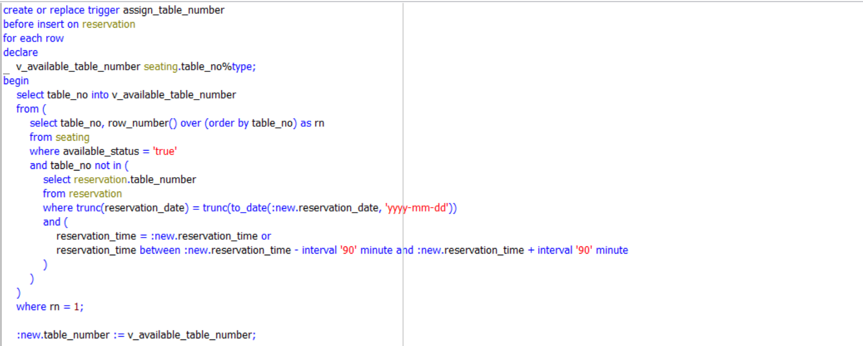
Team 1 co.
Handeling Data using PL/SQL
PL/SQL Queries Integrated With Application
Trigger to assign tables to ‘Dine in with Reservation’

Slide 12
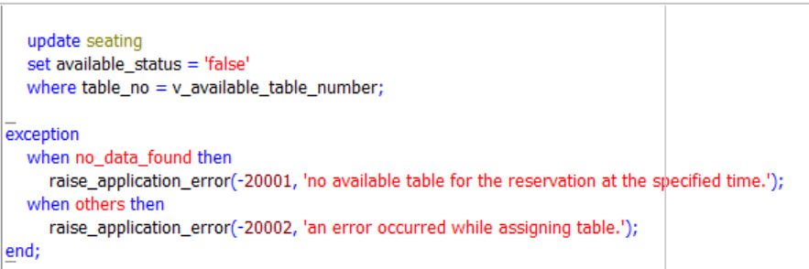
Team 1 co.
Handeling Data using PL/SQL
PL/SQL Queries Integrated With Application
Trigger to assign tables to ‘Dine in with Reservation’

Slide 13
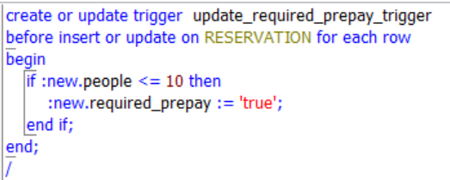
Team 1 co.
Handeling Data using PL/SQL
PL/SQL Queries Integrated With Application
Trigger to check REQUIRED PREPAY

Slide 14
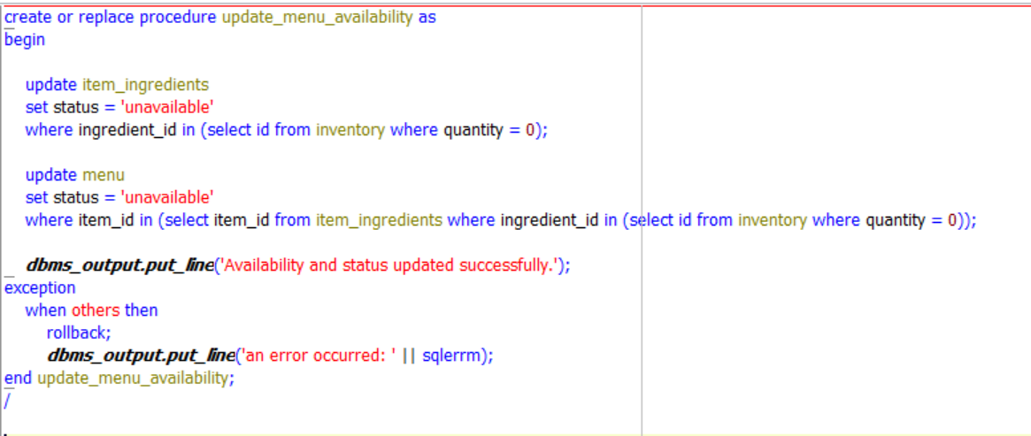
Team 1 co.
Handeling Data using PL/SQL
PL/SQL Queries Integrated With Application
Procedure to Update Menu Items Availability

Slide 15
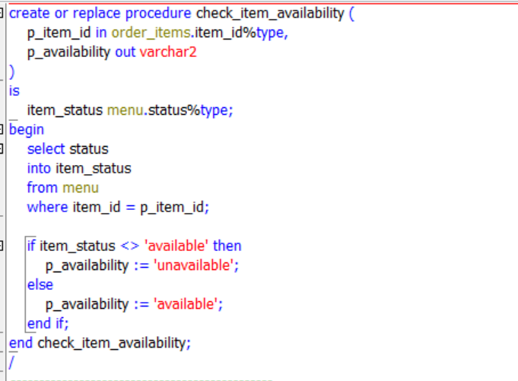
Team 1 co.
Handeling Data using PL/SQL
PL/SQL Queries Integrated With Application
Procedure & Trigger before inserting order items

Slide 16
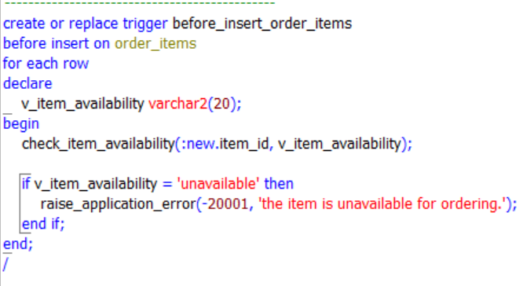
Team 1 co.
Handeling Data using PL/SQL
PL/SQL Queries Integrated With Application
Procedure & Trigger before inserting order items

Slide 17
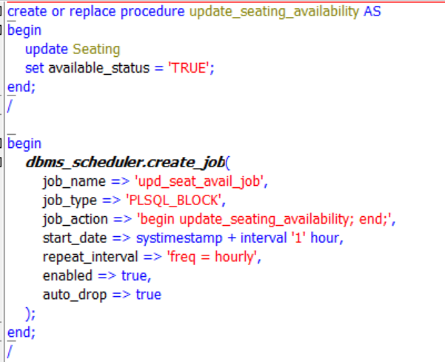
Team 1 co.
Handeling Data using PL/SQL
PL/SQL Queries Integrated With Application
JOB to reset the seating table

Slide 18



Team 1 Co.
Dimensional Modeling
Item Ingredient Fact
Time Fact
Employee Fact
Ingredient Dimension
Item Dimension
Employee Dimension
Order Fact
Supplier Dimension
Seating Dimension
Reservation Fact
Reservation Dimension

Slide 19
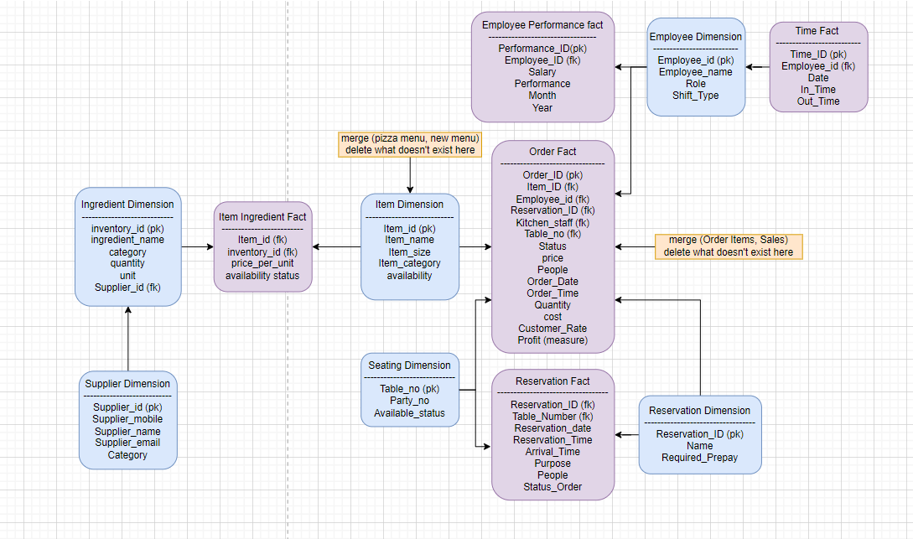
Team 1 Co.
Dimensional Modeling

Slide 20
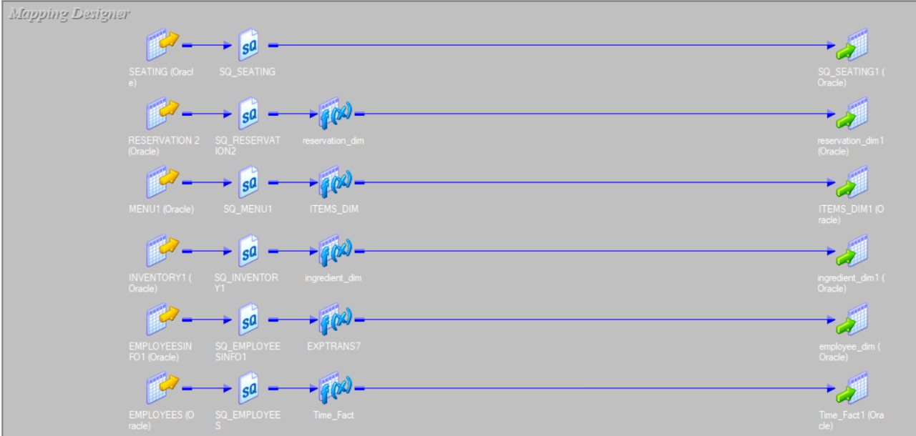
Team 1 Co.
Dimensional Modeling

Slide 21
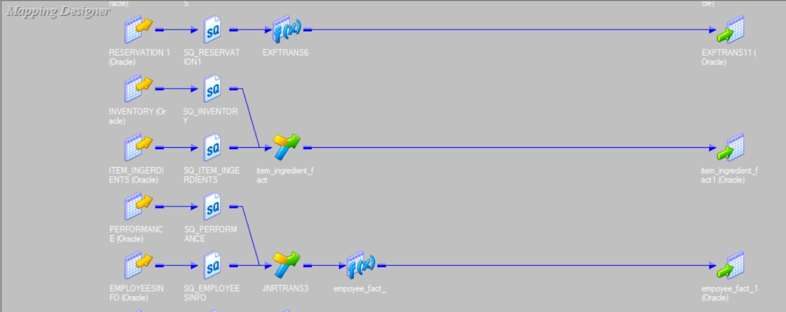
Team 1 Co.
Dimensional Modeling

Slide 22
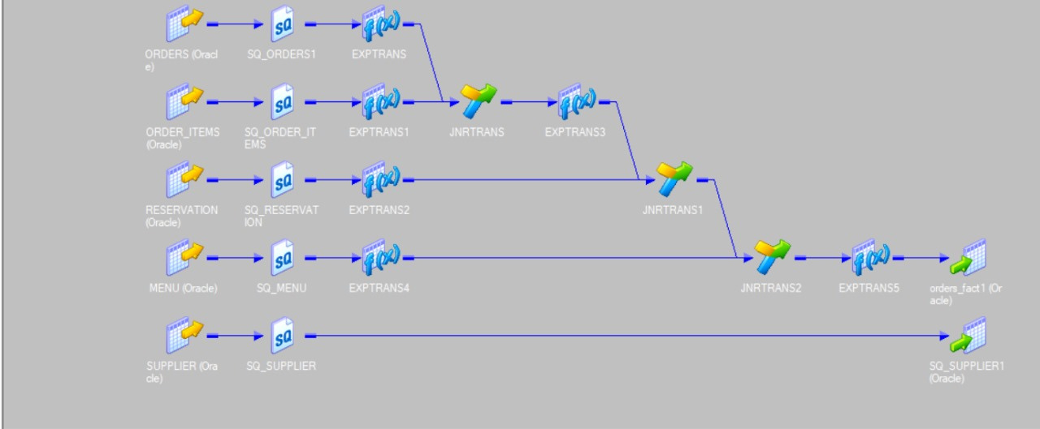
Team 1 Co.
Dimensional Modeling

Slide 23

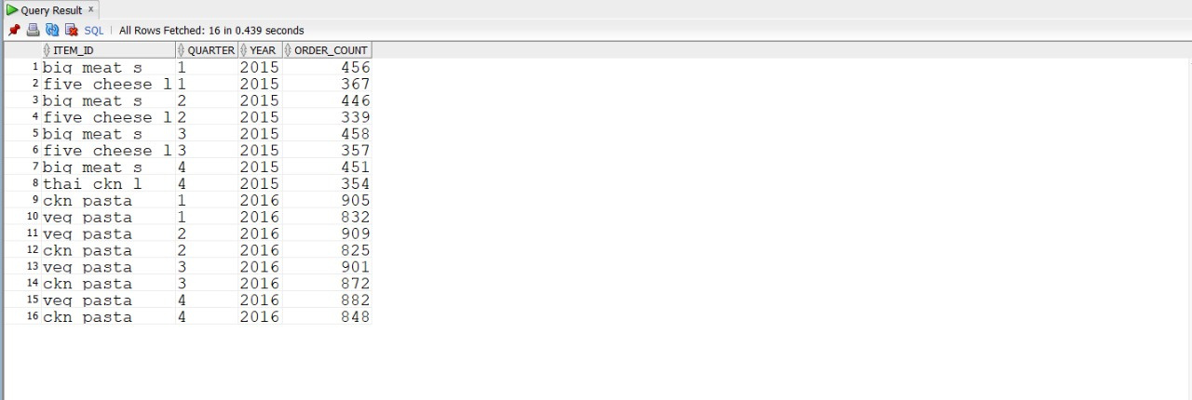

BI Queries To Extract Insights
01
The Top 2 sold items per quarter of every year by Order
WITH OrderCounts AS (
SELECT item_id,
TO_CHAR(TO_DATE(order_date, 'DD-MM-YY'), 'Q') AS quarter,
TO_CHAR(TO_DATE(order_date, 'DD-MM-YY'), 'YYYY') AS year,
COUNT(order_id) AS order_count
FROM orders_fact
GROUP BY item_id, TO_CHAR(TO_DATE(order_date, 'DD-MM-YY'), 'YYYY'), TO_CHAR(TO_DATE(order_date, 'DD-MM-YY'), 'Q')
)
SELECT
item_id, quarter, year, order_count
FROM
( SELECT item_id, quarter, year order_count,
ROW_NUMBER() OVER (PARTITION BY year, quarter ORDER BY order_count DESC) AS row_num
FROM OrderCounts
) ranked
WHERE row_num <= 2
ORDER BY year, quarter;

Slide 24
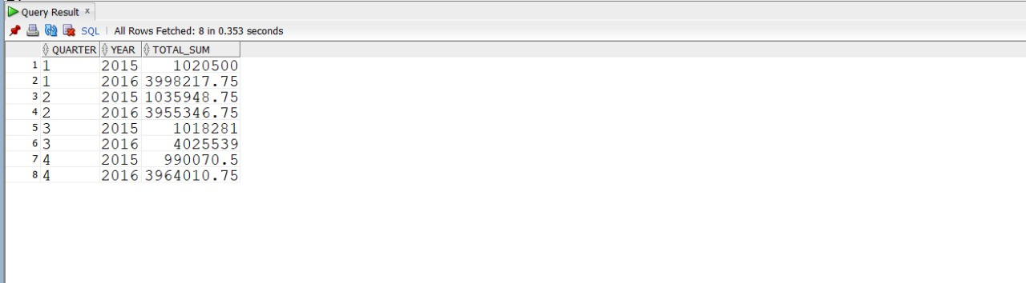
BI Queries To Extract Insights
02
Total Sales Per Quarter Of Every Year
SELECT
DISTINCT TO_CHAR(TO_DATE(order_date, 'DD-MM-YY'), 'Q') AS quarter,
TO_CHAR(TO_DATE(order_date, 'DD-MM-YY'), 'YYYY') as year,
SUM(quantity * price) OVER (PARTITION BY TO_CHAR(TO_DATE(order_date, 'DD-MM-YY'), 'YYYY'),TO_CHAR(TO_DATE(order_date, 'DD-MM-YY'), 'Q')) AS total_sum
FROM orders_fact
ORDER BY quarter;

Slide 25
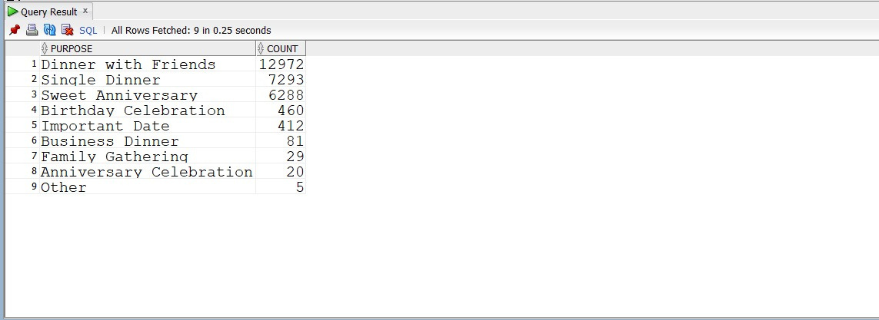
BI Queries To Extract Insights
03
The Purpose People Come To Most (How Perceived Market)
select purpose,count(purpose) as count
from reservation_fact
group by purpose
order by count(purpose) desc;

Slide 26
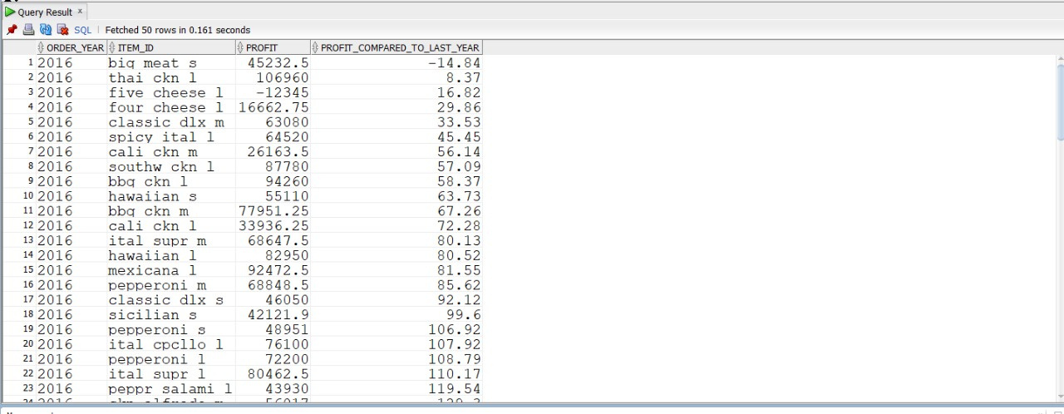
BI Queries To Extract Insights
Comparing The Profit Of Each Item by Year,
Showing the percentage change.
04
WITH Profits AS (
SELECT
TO_CHAR(TO_DATE(order_date, 'DD-MM-YY'), 'YYYY') AS Order_Year,
item_id, SUM(quantity * (price - cost)) AS Profit
FROM orders_fact
GROUP BY TO_CHAR(TO_DATE(order_date, 'DD-MM-YY'), 'YYYY'), item_id
),
PreviousYearProfit AS (
SELECT item_id,Profit AS Current_Year_Profit,
LAG(Profit) OVER (PARTITION BY item_id ORDER BY Order_Year) AS Previous_Year_Profit,
Order_Year
FROM Profits
)
SELECT p.Order_Year, p.item_id, p.Profit,
ROUND(((p.Profit - py.Previous_Year_Profit) * 100 / py.Previous_Year_Profit), 2) AS Profit_Compared_To_Last_Year
FROM Profits p
LEFT JOIN PreviousYearProfit py
ON p.item_id = py.item_id AND p.Order_Year = py.Order_Year
WHERE p.Order_Year = 2016
ORDER BY Profit_Compared_To_Last_Year ;

Slide 27
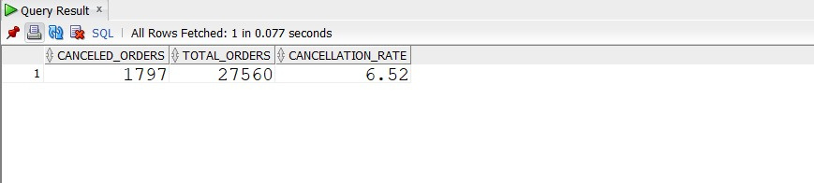
BI Queries To Extract Insights
05
Cancellation Rate
WITH OrderCounts AS (
SELECT COUNT(*) AS total_orders,
COUNT(CASE WHEN status_order = 'Cancelled' THEN 1 END) AS canceled_orders
FROM reservation_fact
)
SELECT canceled_orders, total_orders, round((canceled_orders / total_orders) * 100,2) AS cancellation_rate
FROM OrderCounts;

Slide 28
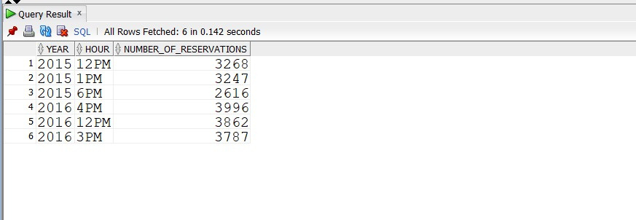
BI Queries To Extract Insights
Ranked Rush Hours For Reservation by Year
06
WITH HourlyReservationCounts AS (
SELECT
TO_CHAR(TO_DATE(order_date, 'DD-MM-YY'), 'YYYY') AS year,
SUBSTR(order_time, 1, INSTR(order_time, ':') - 1) || SUBSTR(order_time, INSTR(order_time, ' ') + 1) AS hour,
COUNT(booking_id) AS number_of_reservations,
ROW_NUMBER() OVER (PARTITION BY TO_CHAR(TO_DATE(order_date, 'DD-MM-YY'), 'YYYY') ORDER BY COUNT(booking_id) DESC) AS hour_rank
FROM orders_fact
GROUP BY
TO_CHAR(TO_DATE(order_date, 'DD-MM-YY'), 'YYYY'),
SUBSTR(order_time, 1, INSTR(order_time, ':') - 1) || SUBSTR(order_time, INSTR(order_time, ' ') + 1)
)
SELECT year, hour, number_of_reservations
FROM HourlyReservationCounts
WHERE hour_rank <= 3
ORDER BY year, hour_rank;

Slide 29
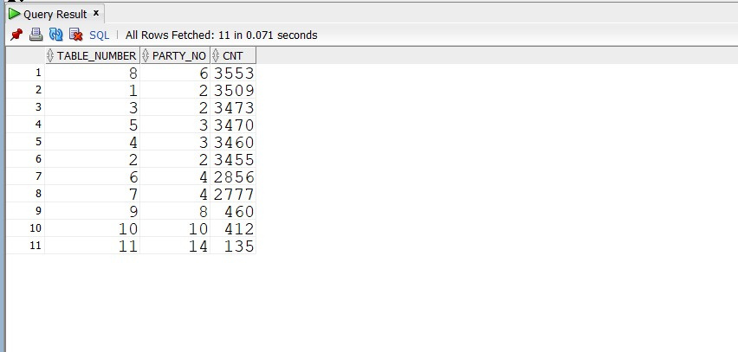
BI Queries To Extract Insights
07
No. Of Reservations For Each Table
SELECT distinct table_number, party_no , COUNT(*)over(partition by table_number)as cnt
FROM reservation_fact , seating_dim
where table_number = table_no
order by cnt desc;

Slide 30
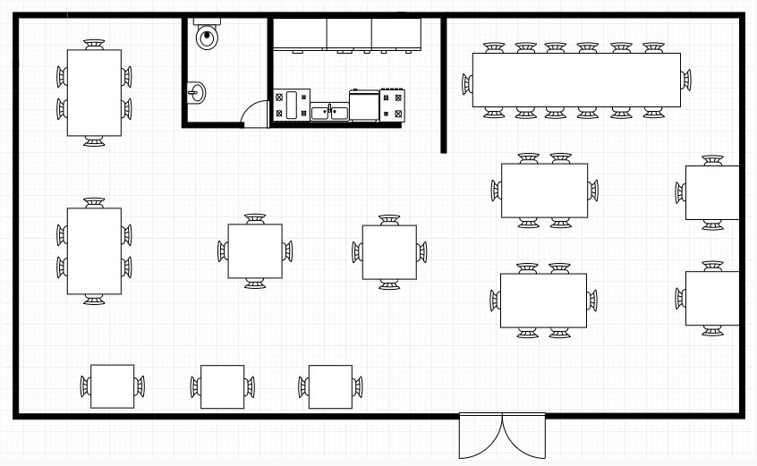
BI Queries To Extract Insights
07
No. Of Reservations For Each Table
SELECT distinct table_number, party_no , COUNT(*)over(partition by table_number)as cnt
FROM reservation_fact , seating_dim
where table_number = table_no
order by cnt desc;

Slide 31

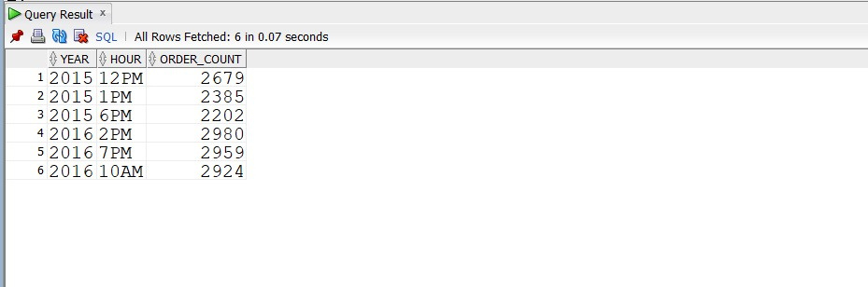

BI Queries To Extract Insights
08
Most Take Away Orders Peak Hours
WITH HourlyOrderCounts AS (
SELECT
TO_CHAR(TO_DATE(order_date, 'DD-MM-YY'), 'YYYY') AS year,
SUBSTR(order_time, 1, INSTR(order_time, ':') - 1) || SUBSTR(order_time, INSTR(order_time, ' ') + 1) AS hour,
COUNT(order_id) AS order_count,
ROW_NUMBER() OVER (PARTITION BY TO_CHAR(TO_DATE(order_date, 'DD-MM-YY'), 'YYYY') ORDER BY COUNT(order_id) DESC) AS hour_rank
FROM orders_fact
where STATUS = 'Take away'
GROUP BY
TO_CHAR(TO_DATE(order_date, 'DD-MM-YY'), 'YYYY'),
SUBSTR(order_time, 1, INSTR(order_time, ':') - 1) || SUBSTR(order_time, INSTR(order_time, ' ') + 1)
)
SELECT year, hour, order_count
FROM HourlyOrderCounts
WHERE hour_rank <= 3
ORDER BY year, hour_rank;

Slide 32
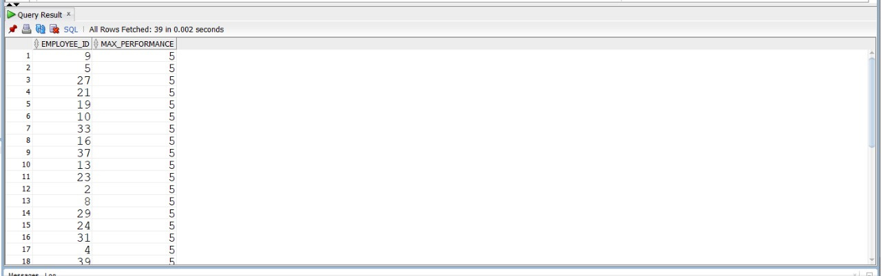
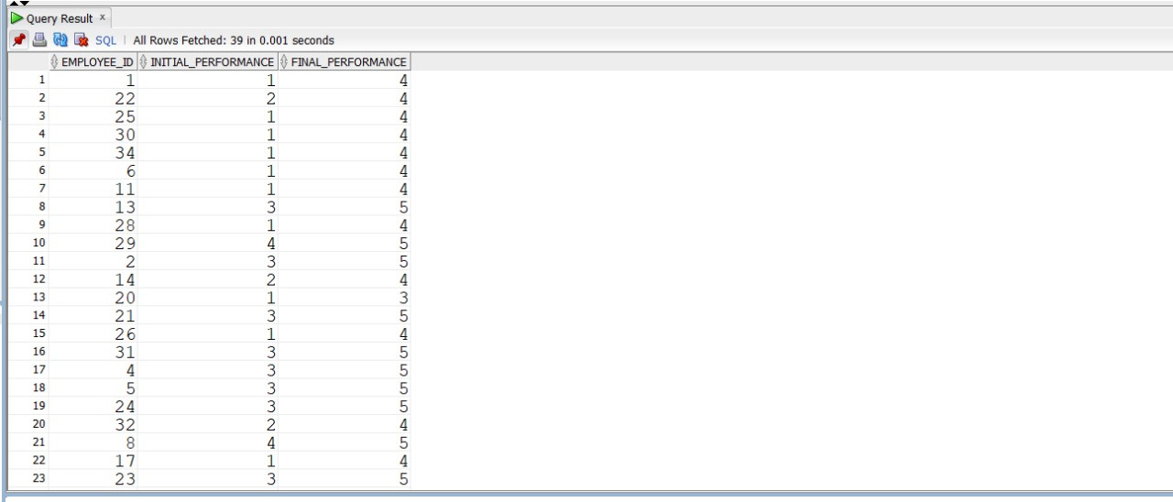
BI Queries To Extract Insights
09
10
Top Performer
Performance Improvement
SELECT employee_id, MAX(performance) AS max_performance
FROM empoyee_fact
GROUP BY employee_id
ORDER BY max_performance DESC;
SELECT employee_id, MIN(performance) AS initial_performance, MAX(performance) AS final_performance
FROM empoyee_fact
GROUP BY employee_id
HAVING MAX(performance) > MIN(performance);

Slide 33
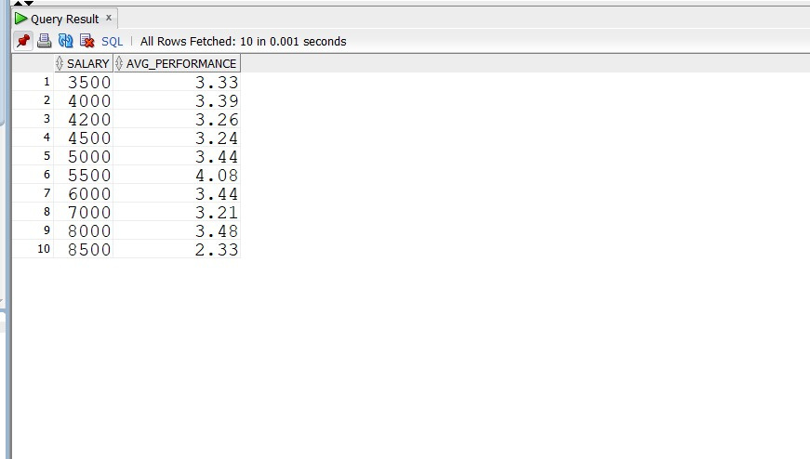
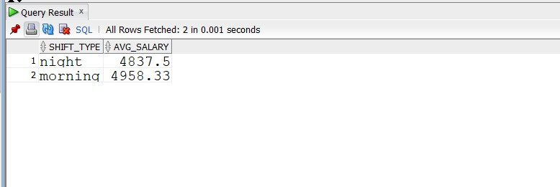
BI Queries To Extract Insights
11
Salary Performance Correlation
12
Average Salary by Shift Time
SELECT salary, round(AVG(performance),2) AS avg_performance
FROM empoyee_fact
GROUP BY salary
ORDER BY salary;
SELECT SHIFT_TYPE, ROUND(AVG(SALARY),2) AS avg_salary
FROM EMPLOYEE_DIM,EMPOYEE_FACT
WHERE EMPLOYEE_DIM.employee_id = EMPOYEE_FACT.employee_id
GROUP BY SHIFT_TYPE;

Slide 34
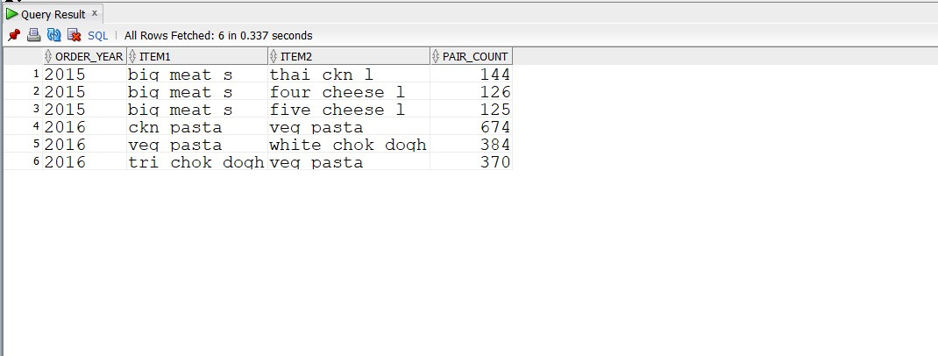
BI Queries To Extract Insights
13
The Frequently Bought Together
3 Items by Year
WITH ItemPairs AS (
SELECT
TO_CHAR(TO_DATE(o1.order_date, 'DD-MM-YY'), 'YYYY') AS Order_Year,
o1.item_id AS Item1, o2.item_id AS Item2, COUNT(*) AS Pair_Count
FROM orders_fact o1
INNER JOIN orders_fact o2
ON o1.order_id = o2.order_id AND o1.item_id < o2.item_id
GROUP BY TO_CHAR(TO_DATE(o1.order_date, 'DD-MM-YY'), 'YYYY'), o1.item_id, o2.item_id
),
RankedPairs AS (
SELECT Order_Year, Item1, Item2, Pair_Count,
ROW_NUMBER() OVER (PARTITION BY Order_Year ORDER BY Pair_Count DESC) AS Rank
FROM ItemPairs
)
SELECT Order_Year, Item1, Item2, Pair_Count
FROM RankedPairs
WHERE Rank <=3 ;

Slide 35
BI Queries To Extract Insights
14
Most Take Away Orders Peak Hours
WITH HourlyOrderCounts AS (
SELECT
TO_CHAR(TO_DATE(order_date, 'DD-MM-YY'), 'YYYY') AS year,
SUBSTR(order_time, 1, INSTR(order_time, ':') - 1) || SUBSTR(order_time, INSTR(order_time, ' ') + 1) AS hour,
COUNT(order_id) AS order_count,
ROW_NUMBER() OVER (PARTITION BY TO_CHAR(TO_DATE(order_date, 'DD-MM-YY'), 'YYYY') ORDER BY COUNT(order_id) DESC) AS hour_rank
FROM orders_fact
where STATUS = 'Take away'
GROUP BY
TO_CHAR(TO_DATE(order_date, 'DD-MM-YY'), 'YYYY'),
SUBSTR(order_time, 1, INSTR(order_time, ':') - 1) || SUBSTR(order_time, INSTR(order_time, ' ') + 1)
)
SELECT year, hour, order_count
FROM HourlyOrderCounts
WHERE hour_rank <= 3
ORDER BY year, hour_rank;

Slide 36

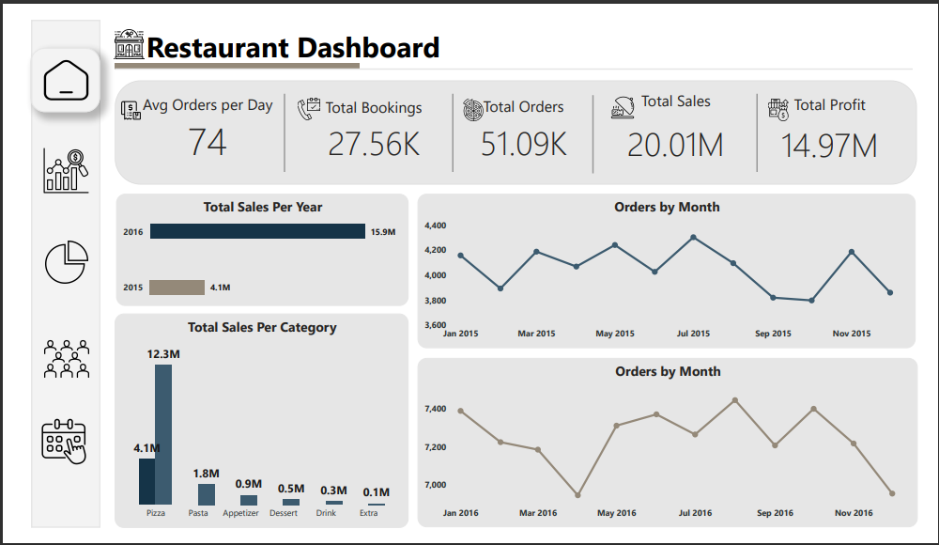
Dashboard

Slide 37
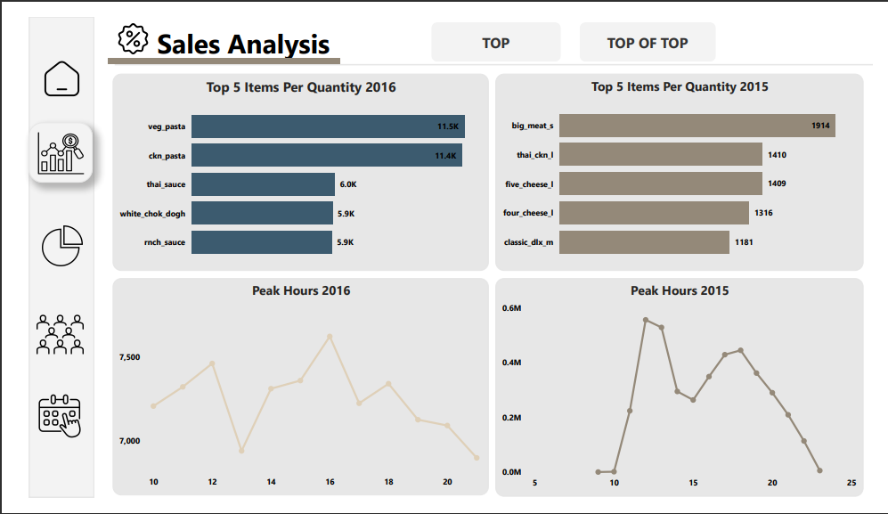
Dashboard

Slide 38
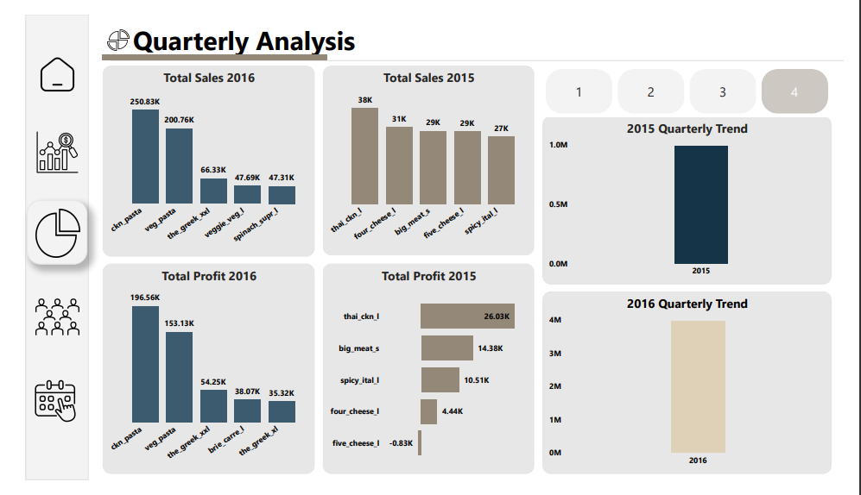
Dashboard

Slide 39
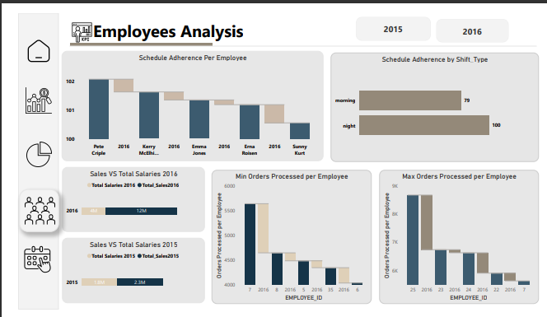
Dashboard

Slide 40
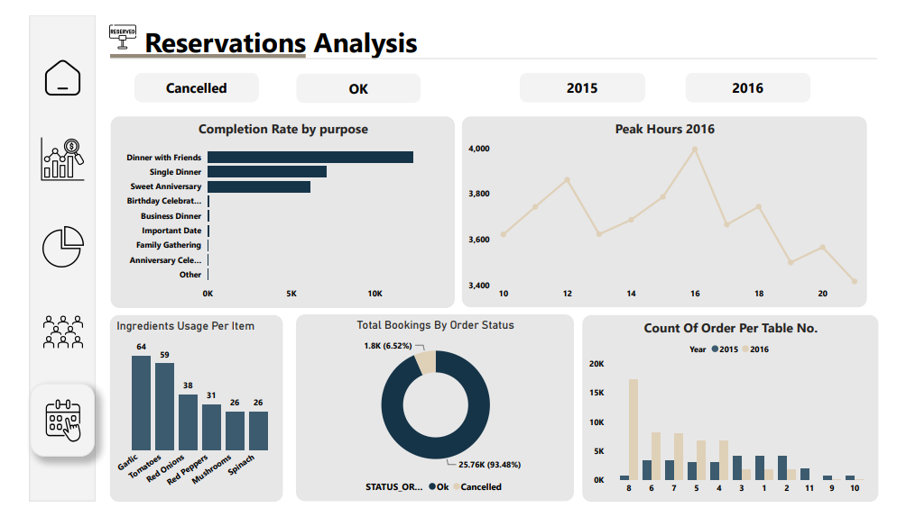
Dashboard

Slide 41


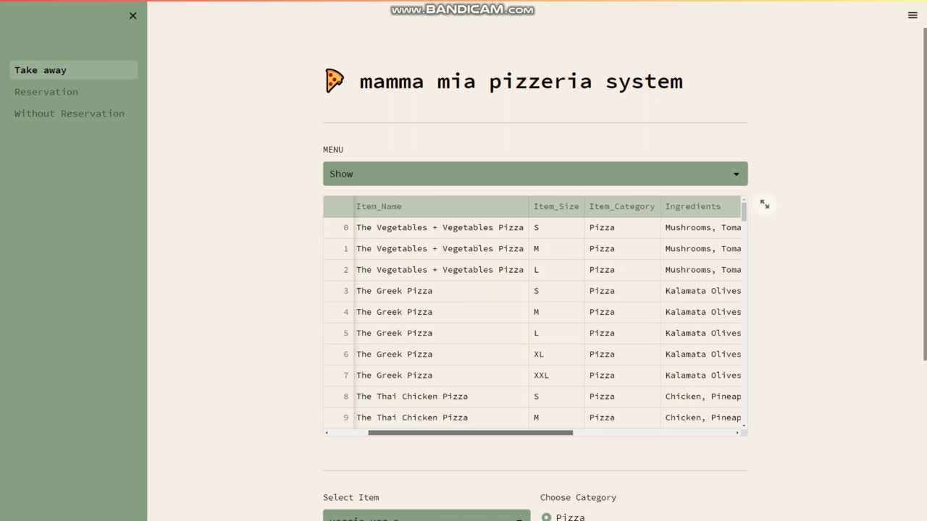



Application Demo
Team 1 co.

Slide 42
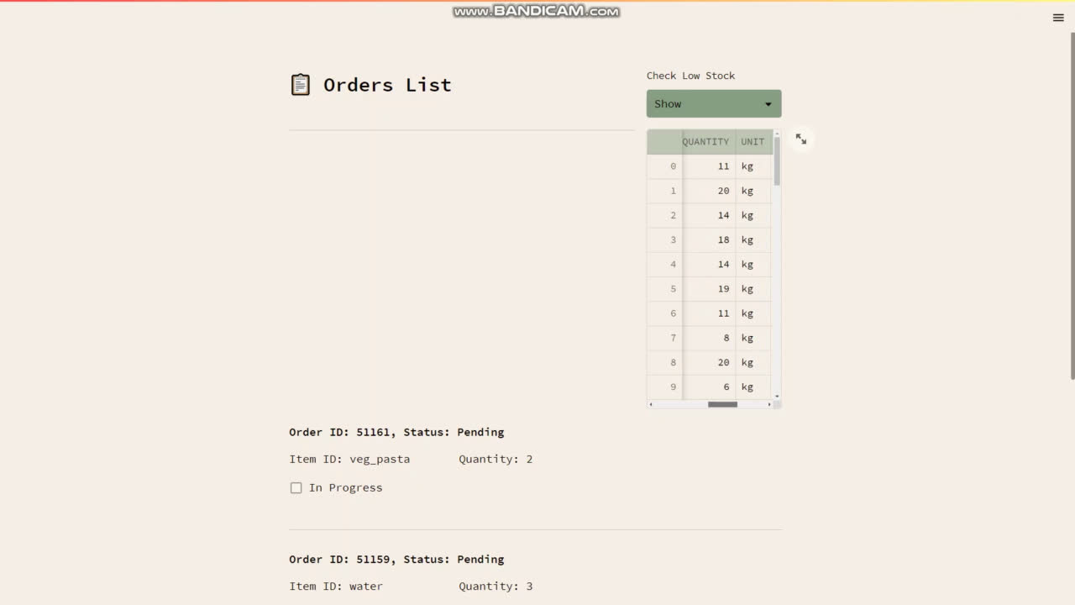
Application Demo
Team 1 co.

Slide 43




Thank You For listening
Team 1 co.

